Slide 1

AFDIA
[Automated Fault Detection Tool-Interface Applicatopm]
Excetive Summary
- AFDIA is a presentation layer upon AFD Tool( tool developed for Cisco to perform tesing on components, it is mono-interface, command-base, without Database). AFDIA is a web-based, concurrent, support Hisory-navigation and maintain resuls in relarion databse.
Submitted To: Prof Fabio Salice
Submitted By: Iqbal, Azhar

Slide 2
- What is AFD Tool and its shortcomings
- Testing Procedure
- Difficulties using current version of AFD Tool
- How we have enhanced AFD Tool’s usage and improve testing procedure
OBJECTIVE

Slide 3
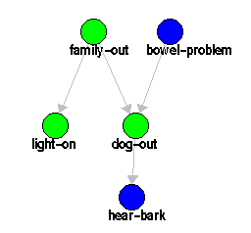
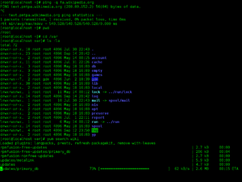

- AFD Tool is an automatic tool for the identification of a failure in a Complex system.
- Tool perform testing on provided CTM Model (Component-test Matrix)
AFD Tool
Based on Bayen Belief Network
AFD Tool
Command-base
Developed using
Identification of failure in Complex system
Set of Electronic components

Slide 4
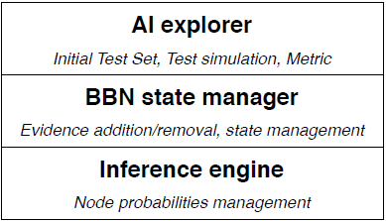
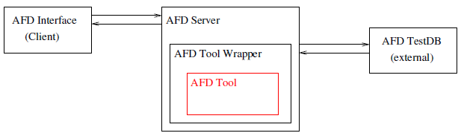
AFD Tool - Architecture
Multi-layered AFD Tool Architecture
Deployment of AFD Tool in User Interface

Slide 5
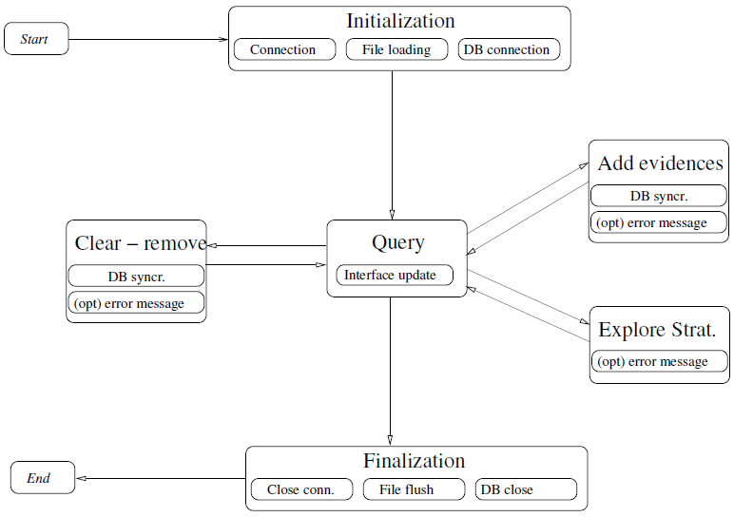
Finite Stat Machine Model of AFD Application

Slide 6




AFD Tool... shortcomings
Data is not stored in Relational format
AFD Tool is missing
Communication between Testing Roles via Email etc
Output format
No History Maintained of Performed Tests

Slide 7

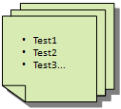
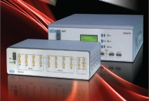
Testing Procedure
Test Engineer
System Under Test
Testing Cycle Completed
View Test Result
Perform Testing
Test Administrator

Slide 8
- AFDIA, is a GUI-based, web-based, Distributed and database oriented user interface layer.
- Separate web consoles for Test Engineer and Test Administrator (Stat Manager)
- its easy to use and handy to perform testing operations
- Maintain history of all performed tests for later visualization
- Developed using .NET Technologies
- it runs on standard web-browser, recommended are IE, Mozilla and Google Chrome.
AFDIA (AFD-Interface application)

Slide 9
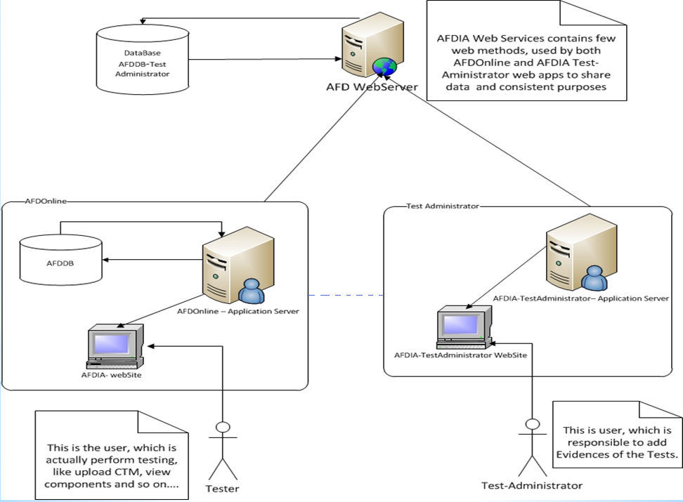
AFDIA - Architecture

Slide 10
- Web-interface
- Interacted by Test-Engineer as AI Explorer (Initial Test Set, Test Simulation and Metric )
- Maintain Relation Database of Performed Tests
- Consume Web-Service exposed by AFD-Web Server
AFDOnline
TestAdministrator
- Web-interface
- Interacted by Test-Administrator as BBN Stat Manager (Evidence addition/Removal, stat management )
- Consume Web-Service exposed by AFD-Web Server
AFD-Web Server
- Expose Web Service via IIS(Internet Information Services)
- AFDOnline and TestAdministrator are consumers
- Maintain Database about Addition/Deleted Evidences, Stat Management

Slide 11
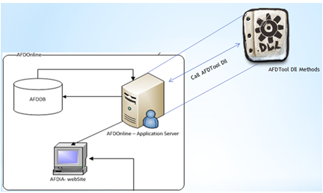
Where AFD Tool Dll Reside in AFDIA

Slide 12
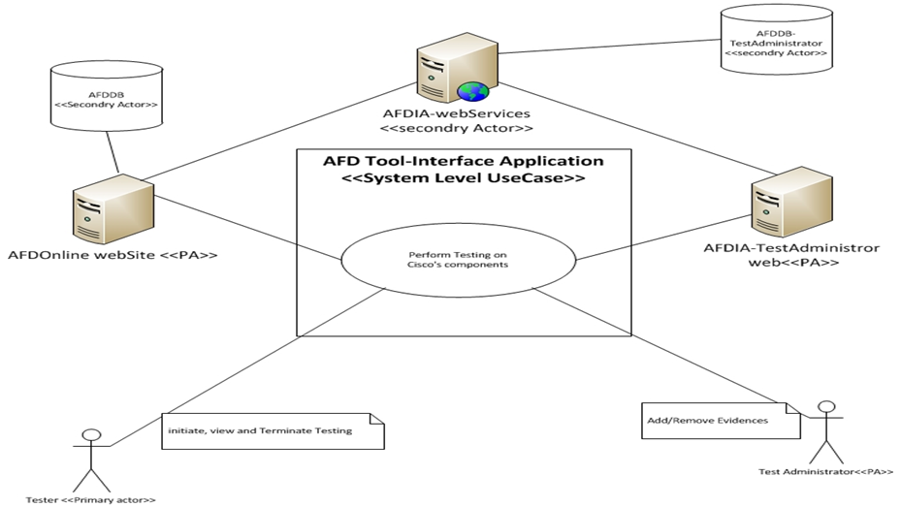
AFDIA – UseCase Diagramme

Slide 13
DEMO

